Slide 1




BRAIN TUMOR DETECTION USING CNNS

Slide 2
ABOUT TEAM
TEAM NO. : 11
Gavendra Pachahra(202401100300111)
Brajesh Keshari(202401100300090)
Lucky Singh(202401100300146)
Dhruv Goel(202401100300100)
SUBJECT : INTRODUCTION TO AI
BRANCH : CSE-AI
SECTION: B

Slide 3
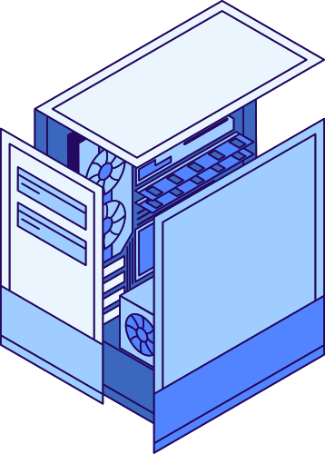
PROBLEM STATEMENT
Brain tumors can be life-threatening if not detected early.
Manual diagnosis from MRI scans is time-consuming and requires expert knowledge.
Goal: Automate detection of brain tumors from MRI images using CNN-based image classification.
Benefits: Faster diagnosis, assist doctors, reduce errors

Slide 4

DATASET
OVERVIEW
Dataset Link: https://www.kaggle.com/datasets/navoneel/brain-mri-images-for-brain-tumor-detection
Classes: Tumor (Yes) and No Tumor (No)
Number of images: ~3,000 (balanced)
Images are resized to 128x128 pixels for model input.

Slide 5
Resized images to 128x128 pixels.
Normalized pixel values to range [0,1].
Split data: 80% training, 20% validation.
Applied data augmentation techniques (optional): rotation, flipping, zoom.
Converted labels to binary format (0 = no tumor, 1 = tumor).
DATA PREPROCESSING

Slide 6

METHODOLOGY — CNN ARCHITECTURE
Input layer: 128x128 RGB images.
Three convolutional layers with filters: 32, 64, 128; activation: ReLU.
MaxPooling layers after each Conv layer to reduce spatial size.
Dropout layer (0.5) to reduce overfitting.
Fully connected (Dense) layer with 128 units.
Output layer with sigmoid activation for binary classification.

Slide 7


CODE SNIPPET
from google.colab import drive
drive.mount('/content/drive')
import numpy as np
import matplotlib.pyplot as plt
import os
import seaborn as sns
from sklearn.metrics import classification_report, confusion_matrix
from tensorflow.keras.preprocessing.image import ImageDataGenerator
from tensorflow.keras.models import Sequential
from tensorflow.keras.layers import Conv2D, MaxPooling2D, Flatten, Dense, Dropout
from tensorflow.keras.optimizers import Adam
# Set dataset paths
train_path = '/content/drive/MyDrive/Colab Notebooks/Dataset/brain/train'
val_path = '/content/drive/MyDrive/Colab Notebooks/Dataset/brain/val'
test_path = '/content/drive/MyDrive/Colab Notebooks/Dataset/brain/test'

Slide 8
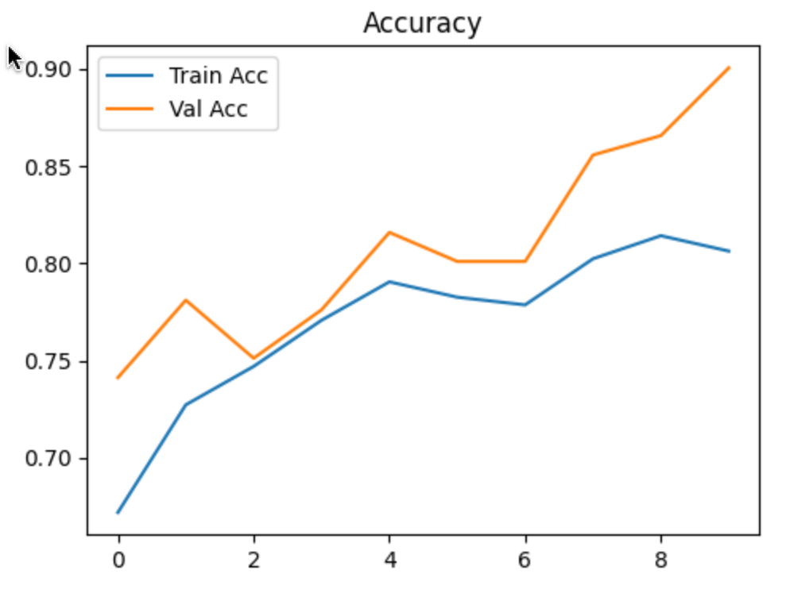
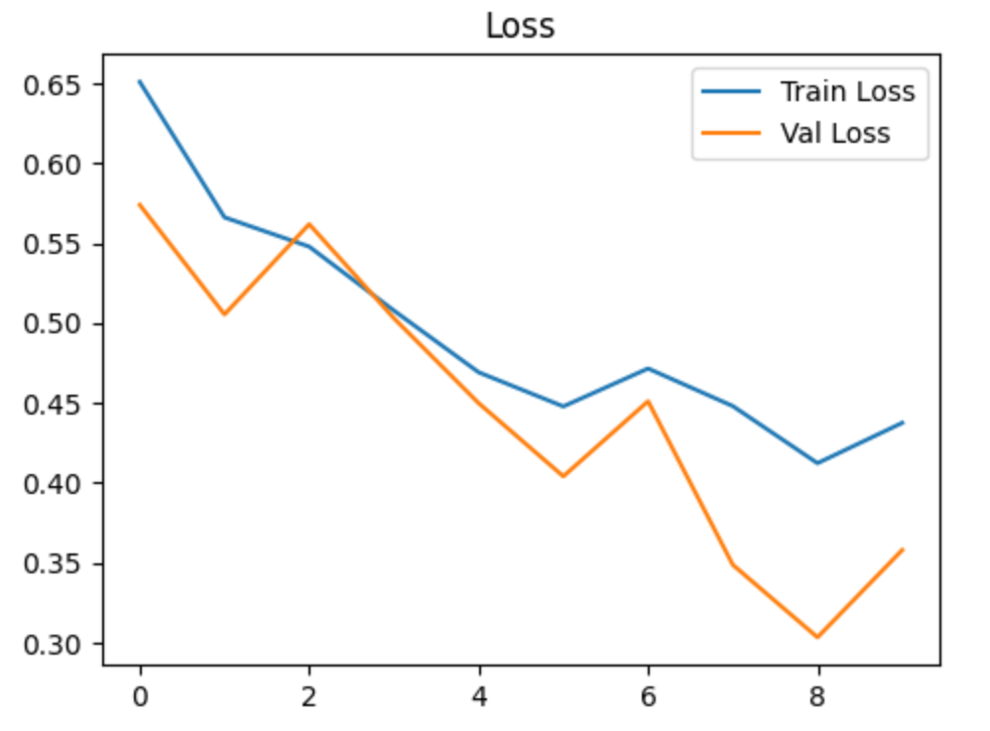
VISUALIZATION OF RESULTS

Slide 9
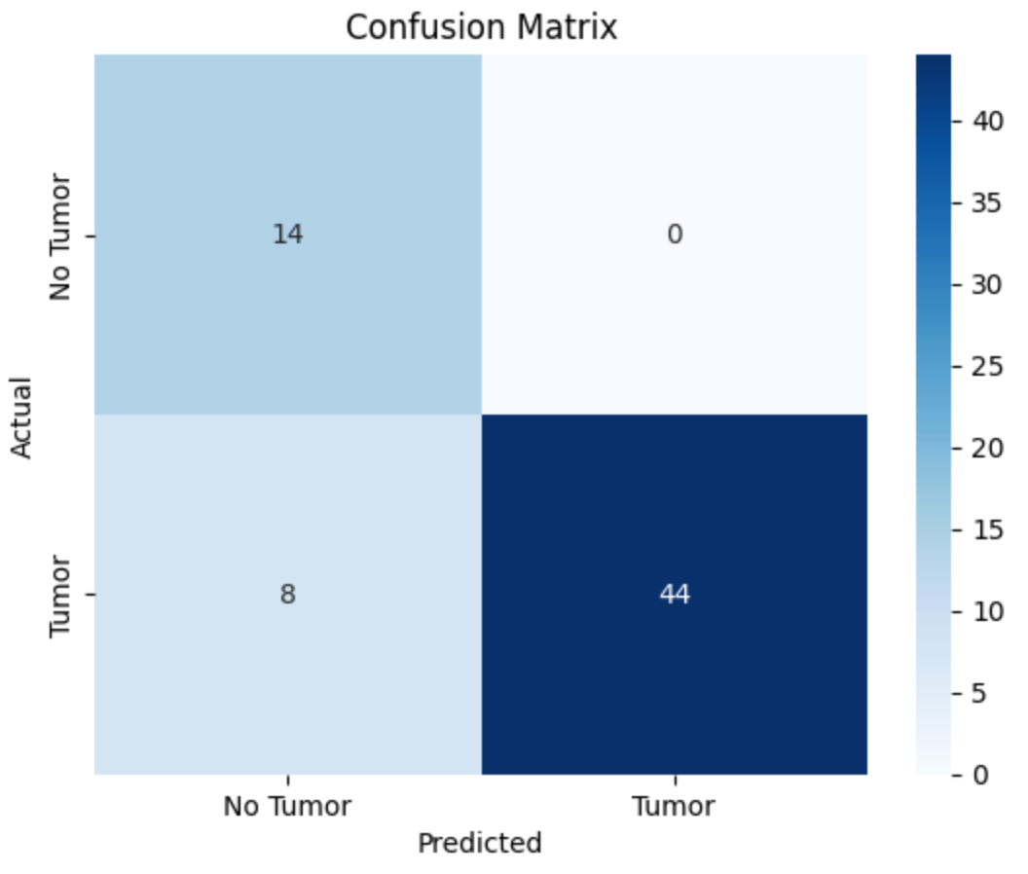
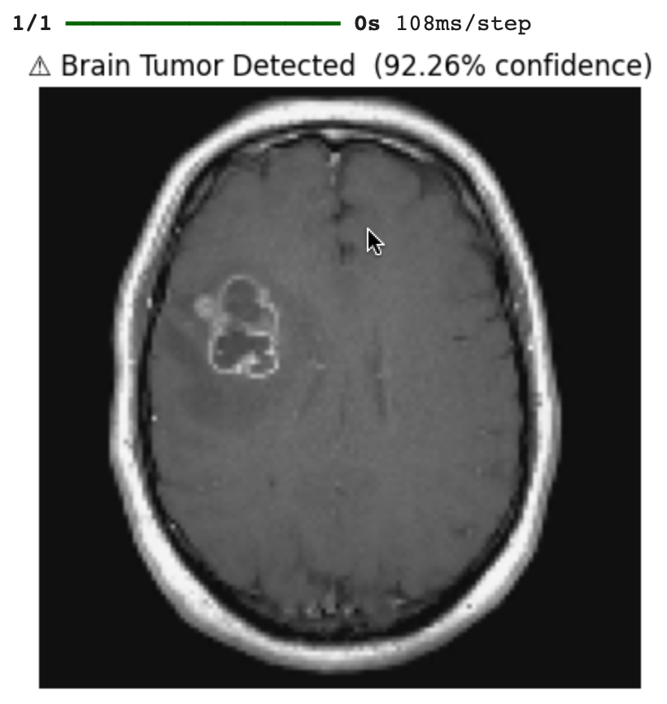
VISUALIZATION OF RESULTS

Slide 10
CONCLUSION
CNN model achieved high accuracy in detecting brain tumors from MRI scans.
Early diagnosis using automated systems can support medical professionals.
Future directions:
Use transfer learning to improve performance.
Classify different tumor types (multi-class classification).
Implement explainability methods like Grad-CAM for clinical trust.
Deploy as a real-time diagnostic tool.

Slide 11
REFERENCES
Navoneel Chakrabarty. Brain MRI Images for Brain Tumor Detection. Kaggle. https://www.kaggle.com/datasets/navoneel/brain-mri-images-for-brain-tumor-detection
Chollet, F. (2017). Deep Learning with Python. Manning Publications.
(For understanding CNN implementation using Keras)
TensorFlow. TensorFlow: An end-to-end open source machine learning platform. https://www.tensorflow.org
A. Krizhevsky, I. Sutskever, and G. E. Hinton. ImageNet Classification with Deep Convolutional Neural Networks. Advances in Neural Information Processing Systems, 2012.

Slide 12
THANK YOU!

